Slide 1
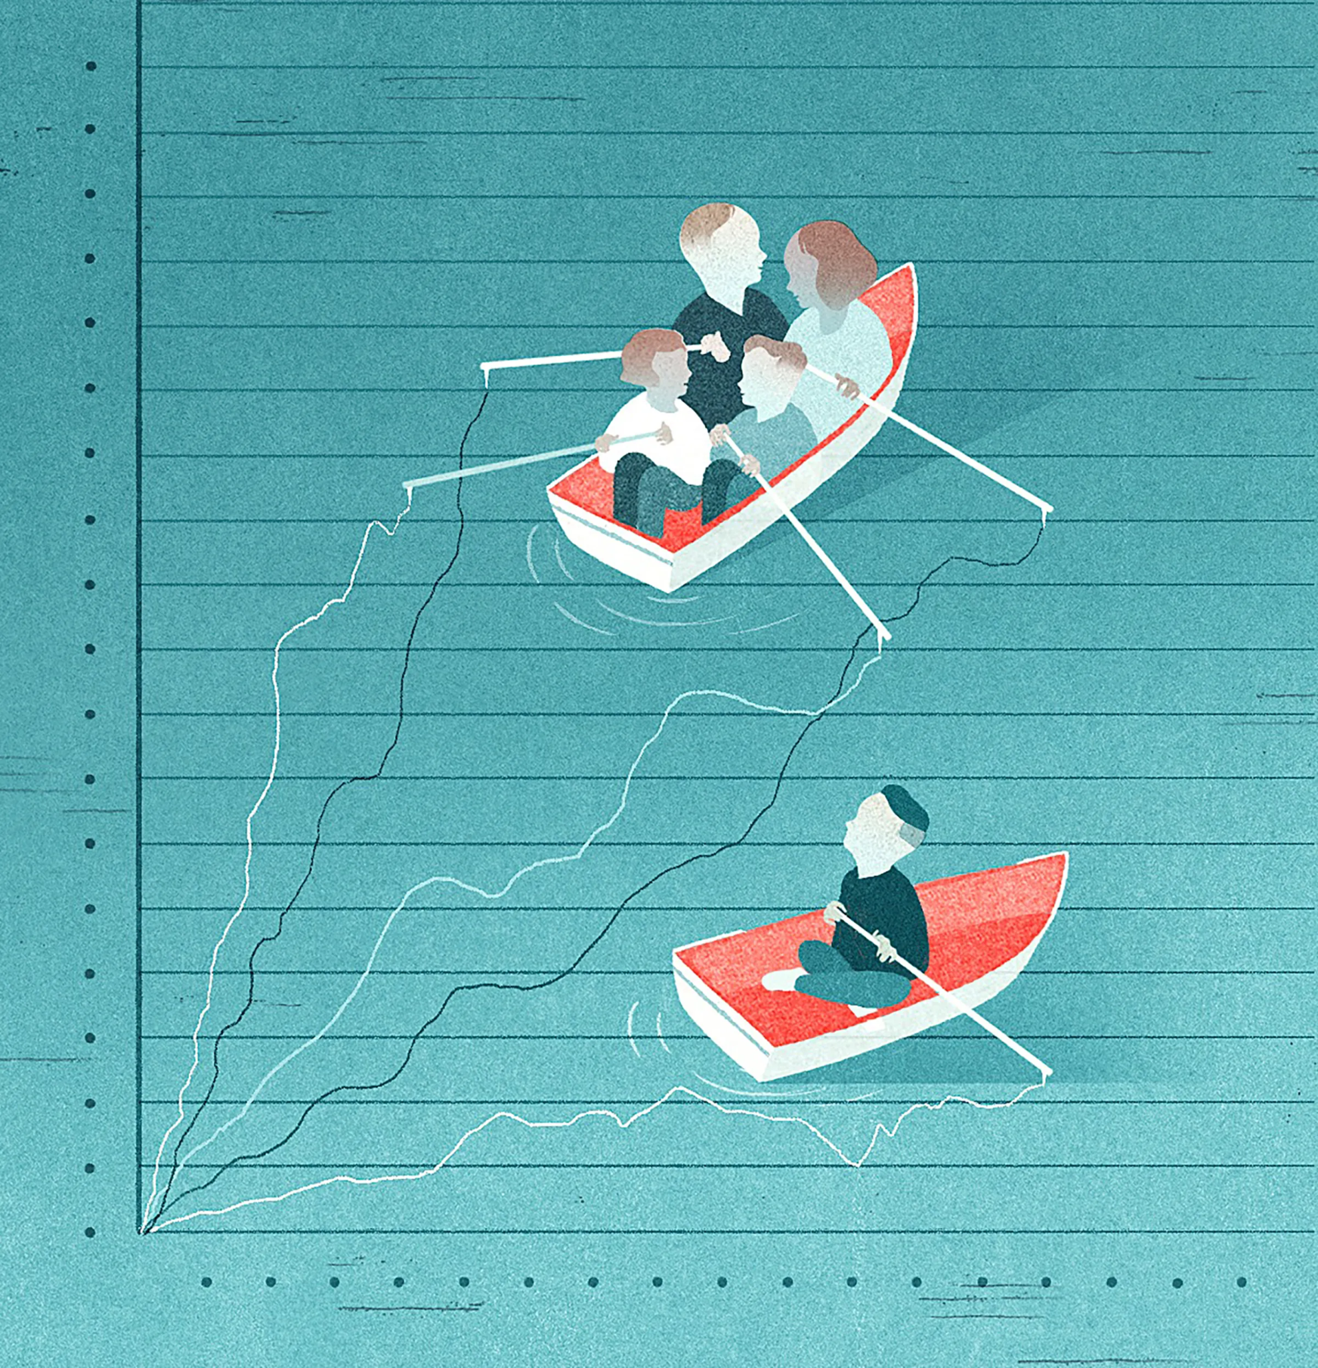
“We have strong expectations around providing for one another and not shirking.”
- James Iveniuk
Postdoctoral Researcher
University of Toronto
with
Demographics Highlighting 25 Diverse Perspectives
*your perspectives

Slide 2

Family and
Societal Bonds:
Understanding & Complexities
Muhammad Ahmad | 21L-5695
Sohaib Ahmad | 21L-5635
Farheen Akmal | 21L-5666
Muhammad Abdullah | 21L-6225

Slide 3



Table Of Contents
01.
Families: Basic Concept
05.
Stages Of Family Life
02.
Marriage and Its Types
06.
Problems in Family Life
03.
Patterns of Family
07.
Alternative Family Forms
04.
Theories Of Family
08.
IVF & Other Technologies
09.
Survey Results

Slide 4
Families
Basic Concepts
Definition of Family: A family is a social unit that forms the primary group of people connected by kinship, either by blood, marriage, or adoption, providing economic and emotional support to its members.
Types of Families:
Nuclear family: Consists of parents and their children.
Extended family: Includes relatives beyond the nuclear family, such as grandparents, etc.
Single-parent family: Comprises one parent raising one or more children.
Definition of Kinship: Kinship involves relationships derived from blood ties, marriage, or adoption, serving as a primary social organizing principle in most societies.

Slide 5
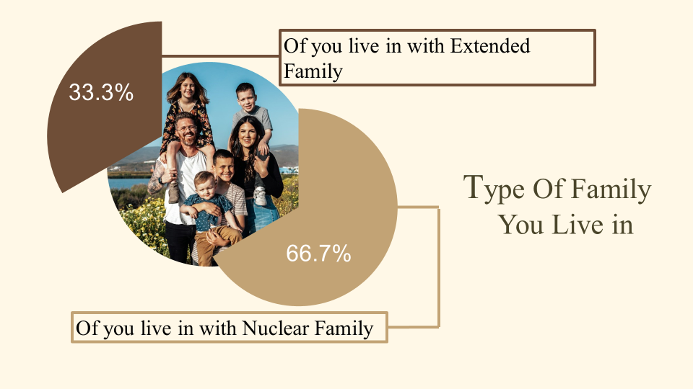

Slide 6

01
Monogamy: Marriage to one spouse at a time.
Marriage and its
Types
02
Polygamy: Marriage to multiple spouses simultane-
ously, further classified as polygyny or polyandry
03
Arranged marriage: Marriages arranged by family members or matchmakers.
Marriage is a culturally sanctioned union between people that establishes rights and obligations between them and their children, and between them and their in-laws.
04
Love marriage: Marriage based on mutual affection and decision.
05
Same-sex marriage: Legal or socially recognized marriage between two individuals of the same sex.
06
Common-law marriage: A marriage recognized legally due to cohabitation, without a formal ceremony.

Slide 7
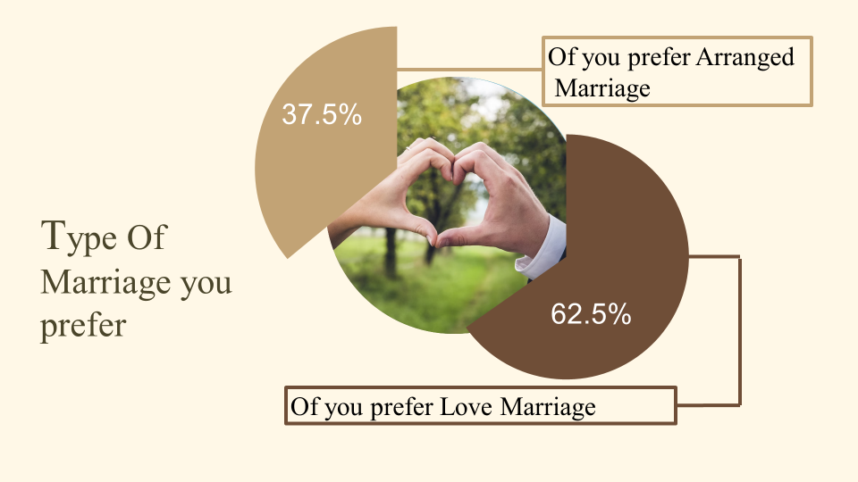

Slide 8

Residential Patterns, Patterns of Descent, and Patterns of Authority
Residential Pattern:
Neolocal: Couples establish a new, separate residence apart from both sets of parents.
Patrilocal: Couples live with or near the husband's parents.
Matrilocal: Couples live with or near the wife's parents.
Pattern of Descent
Patrilineal: Descent and inheritance passed through the male line.
Matrilineal: Descent and inheritance passed through the female line.
Bi-lineal: Descent and inheritance are recognized through both male
and female lines.

Slide 9
Residential Patterns, Patterns of Descent, and Patterns of Authority (Cont.)
Pattern of Authority
Patriarchal: In a patriarchal system, authority and power are predominantly held by men, shaping societal structures with male leadership in politics, business, and family roles etc.
Matriarchal: In a matriarchal system, authority and power are predominantly held by
women, with female perspectives shaping societal decisions, often leading to more
fluid gender roles .
Egalitarian: An egalitarian society promotes equal authority and decision-
making between genders, ensuring both men and women have equal oppor-
tunities in different fields and platforms.

Slide 10
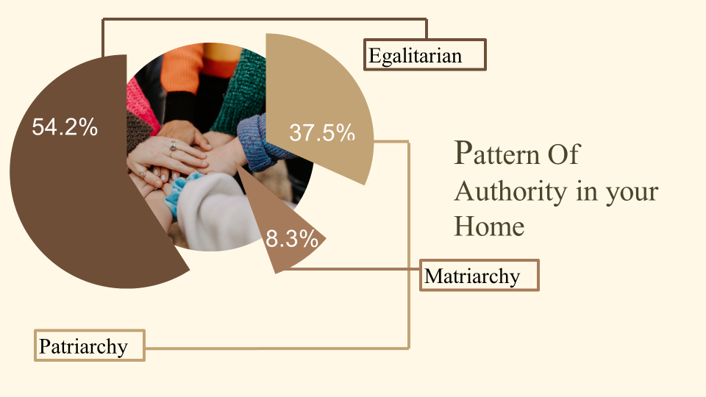

Slide 11

Structural-Functionalism
01
Views the family as a social system with specific functions vital for society's survival, such as socializing children and providing emotional support.
Theories of the Family
Socialization:
Primary setting for child rearing
Parents aid in children's social integration
Regulation of sexual activity:
Cultures regulate sexual activity for kinship and property rights
Social placement:
Parents pass on social identity to children
Material and emotional security:
Family provides physical, emotional, and financial support
Family living associated with happiness, health, and wealth (Goldstein & Kenney, 2001; U.S. Census Bureau, 2010)

Slide 12
Conflict Theory
02
Emphasizes the family as a site of conflict over values, power, and resources, reflecting broader societal inequalities.
Theories of the Family
(Cont.)
Property and inheritance:
Origin traced to men's need to identify heirs, especially in higher classes (Friedrich Engels (1902, orig. 1884)
Families concentrate wealth and reproduce class structure
Patriarchy:
Family linked to patriarchy
Men control women's sexuality to identify heirs
Women become the sexual and economic property of men
Race and ethnicity:
Racial and ethnic categories persist due to endogamous marriage
Endogamy supports racial and ethnic hierarchies

Slide 13
Symbolic Interactionism
03
Focuses on interpersonal relationships within the family, analyzing how family members communicate and build a shared reality.
Theories of the Family
(Cont.)
Symbolic-Interaction Approach:
Family living as an opportunity for intimacy
Intimacy involves sharing activities and building emotional bonds
Parents as authority figures may limit closeness with younger children
Social-Exchange Approach:
Courtship and marriage seen as negotiation
Dating allows assessing advantages and disadvantages of potential spouse
People "shop around" for partners to make the best "deal" (Macionis, 1978).
Traditionally, men bring wealth and power, women bring beauty

Slide 14
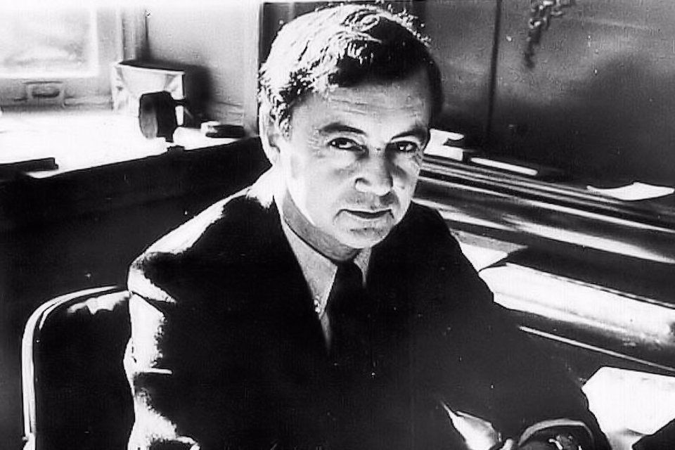
Courtship is a social ritual that combines individual choice with social norms, shaping the foundation of future relationships. - Erving Goffman

Slide 15

Stages of Family Life
Concept of Courtship:
Arranged Marriage: Often facilitated by family or matchmakers, focusing
on compatibility in social status, economic factors, and sometimes love development
post-marriage.
Romantic Love: Relationships that begin based on emotional attachments and personal choice, emphasizing dating and personal connection before commitment.
Settling in:
Ideal Marriage: Often envisioned as a harmonious partnership with shared responsibilities, strong emotional bonds, and mutual support.
Real Marriage: Real-world challenges like managing finances, household duties, and external pressures can strain the marital bond, necessitating strong communication and conflict resolution skills.

Slide 16

Stages of Family Life
Child Rearing:
Parenting Styles: Discuss the effects of authoritative, permissive, and authori-
tarian parenting on child development.
Challenges: Modern challenges such as digital exposure, balancing work and
home life, and maintaining cultural traditions.
Family in Later Life:
Role Reversals: Adult children often become caretakers for their aging parents, impacting family dynamics and responsibilities.
Retirement: Transitioning to retirement can affect family structures and support systems, with a focus on adapting to changes in daily routines and financial status.

Slide 17
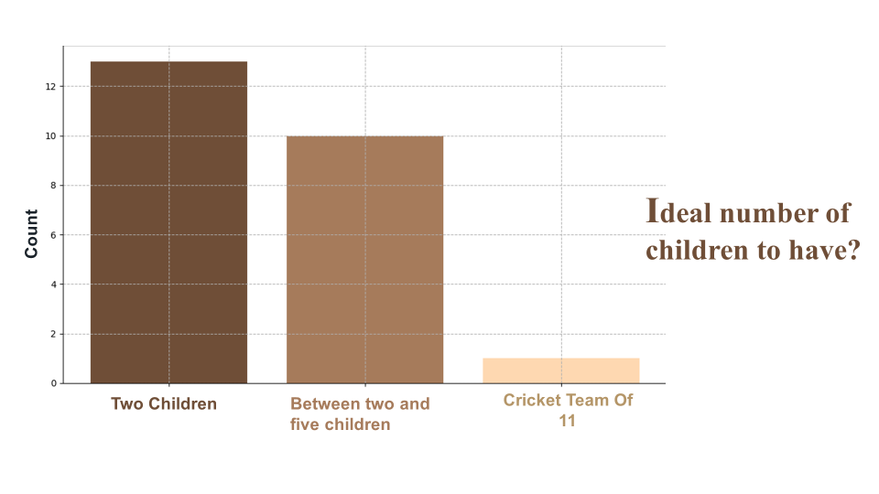

Slide 18

Stages of Family Life
Death of a Spouse:
Grief Process: Different stages of grief including denial, anger, bargaining,
depression, and acceptance. Important for understanding individual responses and
needs during bereavement.
Adjustment: Practical adjustments like financial management, living arrangements, and re-entering social life can be significant challenges.
Support Systems: The role of family, friends, and professional counseling in aiding the surviving spouse through this transition.

Slide 19
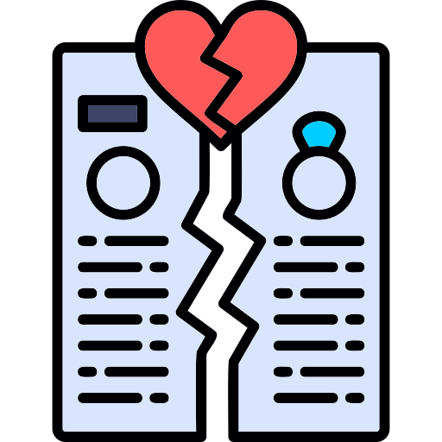
Transitions & Problems in Family Life
Divorce is the legal dissolution of a marriage by a court or other competent body. It marks the formal end of a marital union, terminating the marital bonds and responsibilities between the parties involved under the rule of law of the country or state.
Reasons for Divorce:
Individualism is on the rise : Today’s family members spend less time together. We have become more individualistic.
Romantic love fades : Many people end a marriage in favor of a new relationship that promises renewed excitement and romance.
Women are less dependent on men: Women’s increasing participation in the labor force has reduced wives’ financial dependence on husbands.
Many of today’s marriages are stressful : With both partners working outside the home in most cases, jobs leave less time and energy for family life. This makes raising children harder than ever.
Divorce has become socially acceptable : Divorce no longer carries the powerful stigma it did several generations ago.
Incompatibility: Over time, couples may find their values, interests, or life goals have diverged too significantly to reconcile.

Slide 20
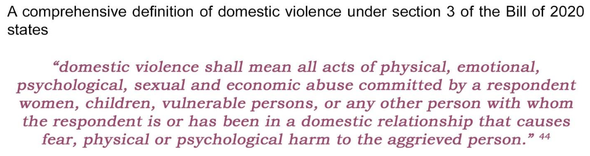
Domestic Violence ( Prevention and Protection) Bill 2020

Slide 21
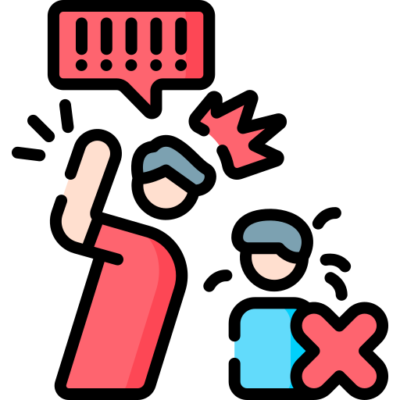
Transitions and Problems in Family Life
Family Violence:
Violence Against Women: Includes domestic violence, coercive control, and marital
rape, highlighting the need for legal protections and support services.
Violence Against Children: Covers physical abuse, emotional maltreatment, and neglect, emphasizing the importance of protective services and therapeutic interventions.
Remarriage and Blended Families:
Remarriage: The act of marrying again after a divorce or death of a spouse, often bringing together children from previous relationships.
Blended Families: Families formed by remarriage that include step-parents
and step-siblings. Challenges include navigating relationships, bonding, and
establishing roles within the new family structure.

Slide 22
Alternative Family Forms
Cohabitation: Couples who live together without being legally married, often as a precursor
to marriage or as a long-term alternative.
Adoptive Families: Families that have legally adopted one or more children, Adoption
involves a process of legally assuming parental rights and responsibilities.
Foster Families: Families which provide temporary care for children whose biological
parents are unable to care for them.
Childfree Families: Couples or individuals who choose not to have children, discussing societal perceptions, reasons for this choice, and implications on personal and professional life.
Single-Parent Families: Single-parent families are led by a single parent, often due to
divorce, separation, or choice. These families face unique challenges and rely on societal support.

Slide 23
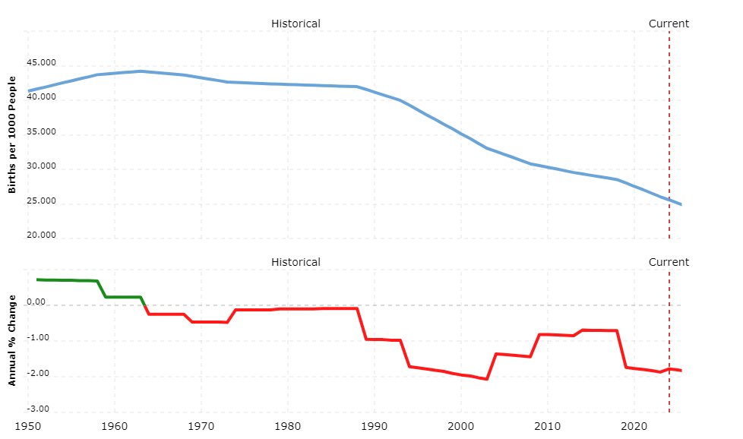
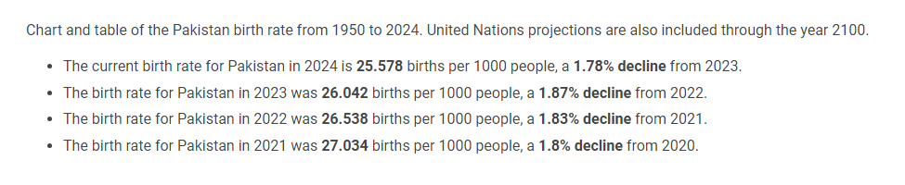
Pakistan Birth Rate 1950-2024

Slide 24
Test Tube Baby
(In Vitro Fertilization - IVF)
Surrogacy: Surrogacy is an agreement where a woman carries and delivers a child for another person or couple.
Pakistan Journal of Public Health study:
Sperm and Egg Donation: This involves donating sperm or eggs to help another individual or couple conceive a child.
21% of couples in Pakistan face infertility.
Male contribute to 37% of cases.
Female contribute to 51% of cases.
Both genders contribute to 12% of cases.
Both process involves complex legal agreements
and can raise emotional and ethical considera-
tions regarding the surrogate’s relationship with
the child, the rights of children conceived through donation to know their biological origins.
Definition: IVF is a medical procedure where an egg and sperm are combined outside the body to create an embryo, which is then implanted in the uterus.
Social and Ethical Implications
Legal Aspects
Other Reproductive Technologies

Slide 25


End of Presentation
Thank You

